Slide 1
The Benefits of Achieving a Made-in-Canada Solution to FPIC in the Forestry Sector
Forest Stewardship and FPIC
December 3, 2014
Karen Clarke-Whistler
Chief Environment Officer
TD Bank Group

Slide 2
Sustainable Economic Development for Aboriginal Peoples

Slide 3


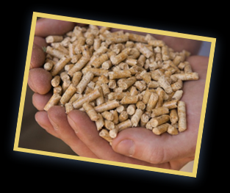


Transformation of the Forest Products Sector
New consumer products from wood fibre
Bio-refineries: chemical pulping to produce wood based polymers, chemicals, and fuels
Bio-materials: nano-crystalline cellulose: bio-plastics, improved textiles, enhanced papers, improved plastics and specialized coatings
Bioenergy: solid and liquid fuels

Slide 4


















FSC from a User’s Perspective:
WHO USES FSC?
Everyone!

Slide 5
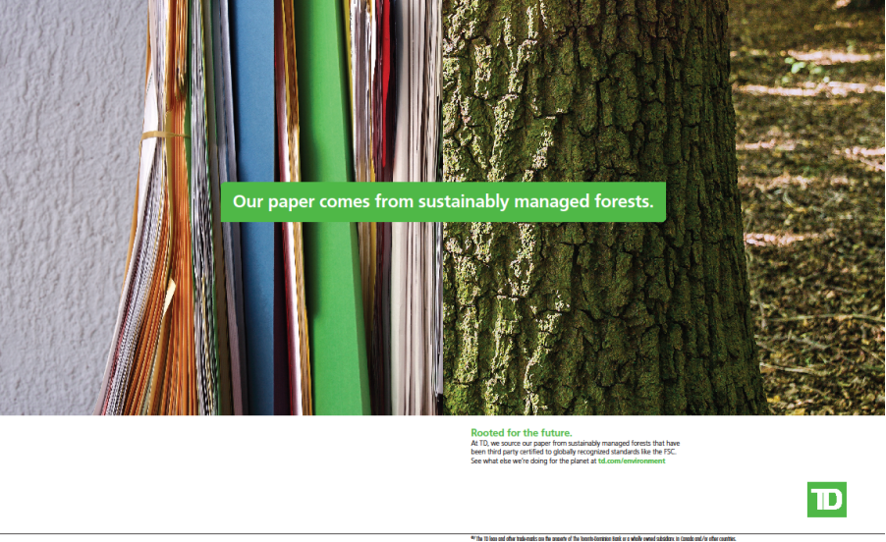
Your BRAND is OUR BRAND

Slide 6

Boreal Leadership Council: 50/50
Committed to preserving at least half of the Boreal Forest in a network of large interconnected protected areas AND
Support sustainable communities, world-leading ecosystem-based resource management practices and state-of-the-art stewardship practices in the remaining landscape.
Alberta Pacific Batirente Cdn Boreal Initiative CPAWS Delcho First Nations Desjardins Funds Domtar Ducks Unlimited Innu Nation | Kaska Nation Pembina NEI Investment Fund Poplar River First Nation Suncor TD Bank Group Tembec Treaty 8 First Nations

Slide 7
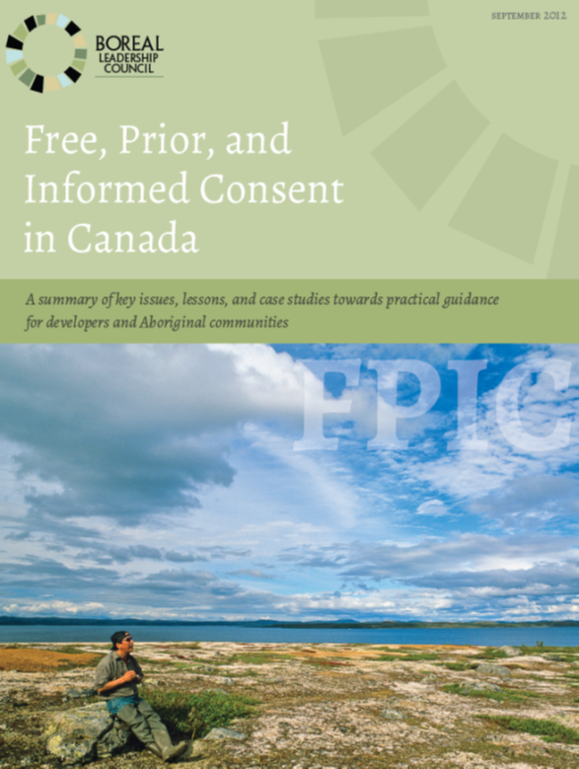
Practical Guidance on FPIC
Boreal Leadership Council
2012: Practical Guidance for developers and aboriginal communities
2015: Examples of Canadian Best Practice Examples of FPIC

Slide 8
Key Elements of FPIC
FREE | Free of coercion, manipulation, or intimidation | Applies equally to developers, government, non-governmental organizations, and communities
 | Adequate capacity to decide, free of pressure | Self-sufficiency and ability to be self-determining in decision making in a community
PRIOR | Early triggers of FPIC | Triggers will vary by scale of project and extent of community impacts.
 | Life cycle approach | FPIC must also be maintained over the life cycle of the project.
 | Timing | Sufficient time for making decisions in advance
INFORMED | Balanced information | Relevant, information from a variety of sources and perspectives.
 | Trusted | Information should not be seen as one-sided or biased.
 | Accessible and Inclusive | Inclusive of a broad range of community and stakeholder groups and interests.
 | Capacity, expertise and financing | Adequate financial resources and capacity to properly make a decision.
 | Understanding dissent | When there is strong dissent, the basis and underlying factors need to be understood.

Slide 9
Key Elements of FPIC
CONSENT | Definition of consent | Confirm the process both for attaining consent and maintaining consent and obtain agreement from all parties at the beginning of the process.
 | Broad-based consent | Use multiple processes and seek to build consent.
 | Dispute resolution | Should be defined as part of the consent process and as part of the ongoing implementation plan.
 | Ratification of decision | Define the mechanisms for determining community support and what constitutes an acceptable outcome.
 | Documentation | Document the consent process.
 | Consent through the project life cycle | Consent can be given or removed at different stages of the project, and can take different forms.
 | A "no" decision | Understanding of a “no” decision by communities.

Slide 10
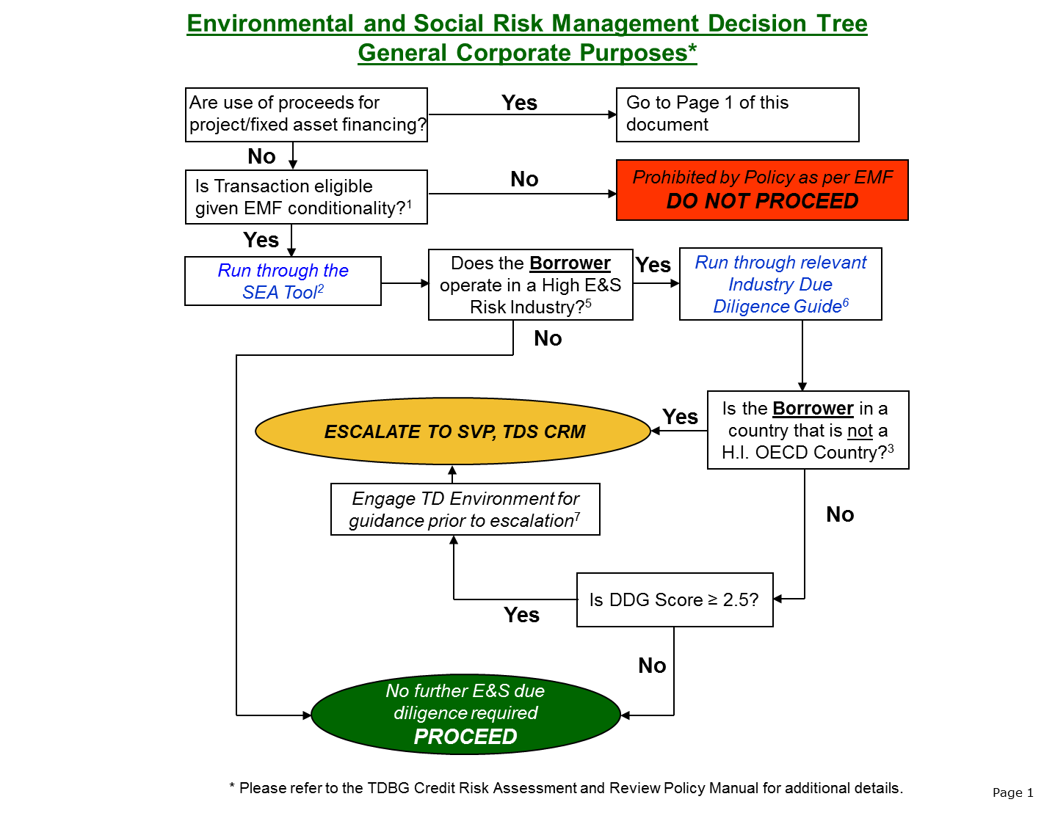
Environmental and Social Risk Assessment

Slide 11
Concluding Thoughts

